Slide 1

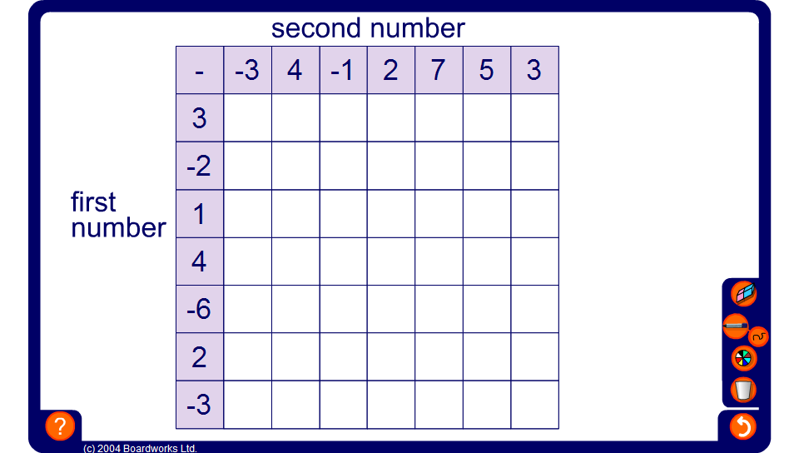


Mixed subtraction square
Notes:
Work out the numbers in the empty squares by adding and subtracting.

